Slide 1

Location and Maps. Sensors.
Maxim Leykin (maxim.leykin@gmail.com)

Slide 2
Location Providers

Slide 3

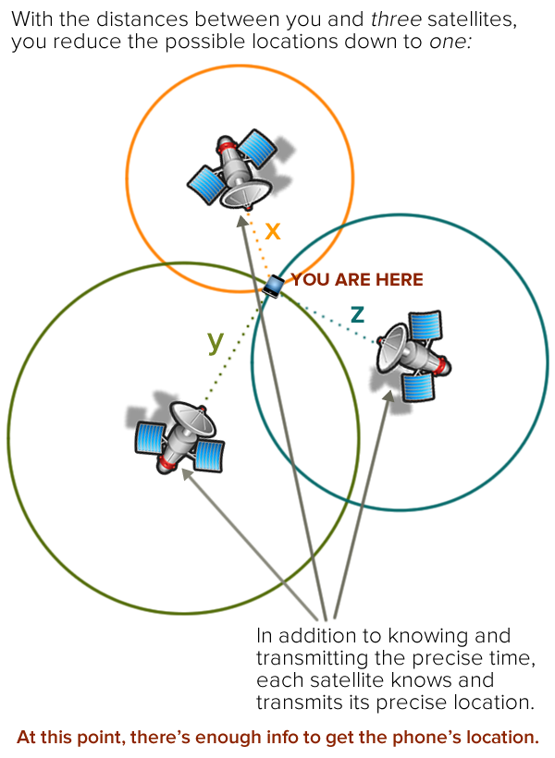
Option to Get Location Information
All Android devices have GPS sensor and API intended to work with geolocation info and maps. You can determine location on Android using the following options:
GPS sensor
Cell-ID
Wi-Fi

Slide 4
Location Manager and Location Provider
LocationManager locMgr = (LocationManager) this.getSystemService(Context.LOCATION_SERVICE); locMgr.requestLocationUpdates(mode, 0L, 0, this);
mode:
GPS_PROVIDER - геонинформацию получаем через GPS
NETWORK_PROVIDER – геоинформацию получаем через CellID или WiFi
Permissions:
<uses-permission android:name="android.permission.ACCESS_FINE_LOCATION" />
<uses-permission android:name="android.permission.ACCESS_COARSE_LOCATION" />

Slide 5
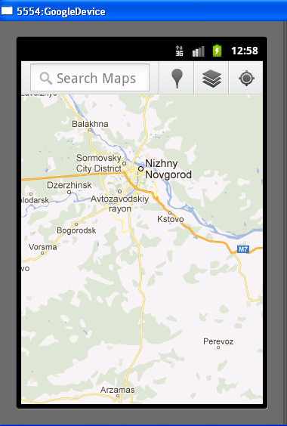
Location Manager and Location Provider
Uri uri=Uri.parse("geo:"+_lat+","+_lon);
startActivity(new Intent(Intent.ACTION_VIEW, uri));
Sample: GeoLocation

Slide 6
Working with
Google Maps

Slide 7
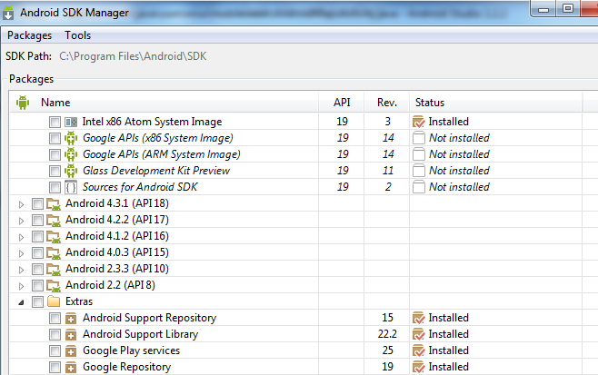
Embedding Google Maps into the App
1. Using Android SDK Manager ensure that Google Play Services are installed:

Slide 8
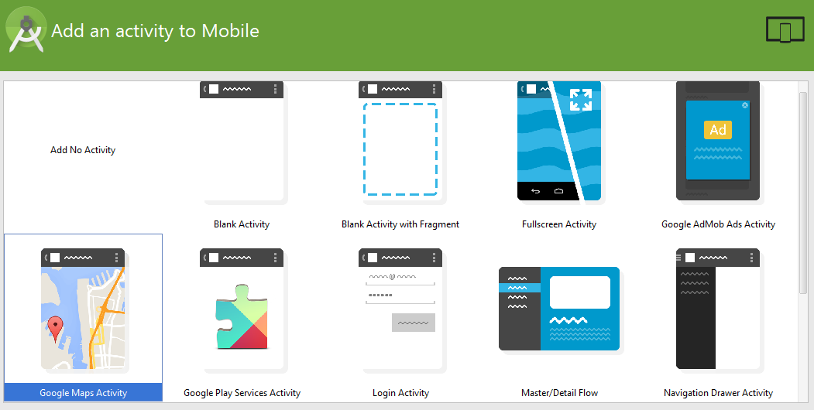
Embedding Google Maps into the App
2. Choose Google Maps Activity as a target for new project:

Slide 9
Embedding Google Maps into the App
3. Open google_maps_api.xml file:
<resources>
<!--
TODO: Before you run your application, you need a Google Maps API key.
To get one, follow this link, follow the directions and press "Create" at the end:
https://console.developers.google.com/flows/enableapi?apiid=maps_android_backend&keyType=CLIENT_SIDE_ANDROID&r=86:8A:55:19:8B:E6:B6:AC:EA:F0:87:D3:B4:F1:37:2F:BC:6D:C2:28%3Bmera.hse.mleykin.mapsdemo
You can also add your credentials to an existing key, using this line:
86:8A:55:19:8B:E6:B6:AC:EA:F0:87:D3:B4:F1:37:2F:BC:6D:C2:28;mera.hse.mleykin.mapsdemo
Once you have your key (it starts with "AIza"), replace the “google_maps_key“ string in this file. -->
<string name="google_maps_key" translatable="false“ templateMergeStrategy="preserve">
YOUR_KEY_HERE
</string>
</resources>

Slide 10
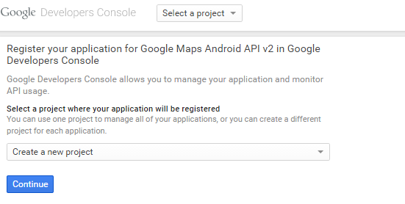
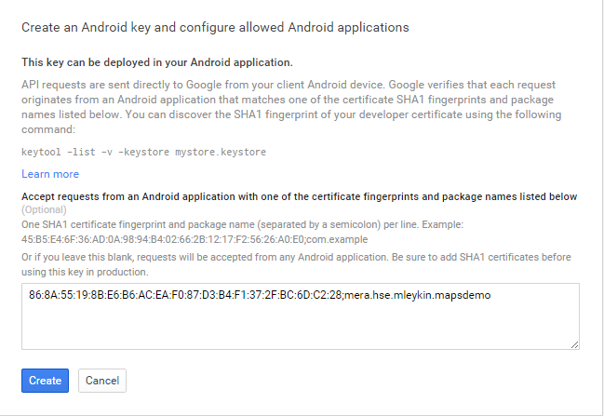
Embedding Google Maps into the App
4. Insert link in browser and create API_KEY:

Slide 11
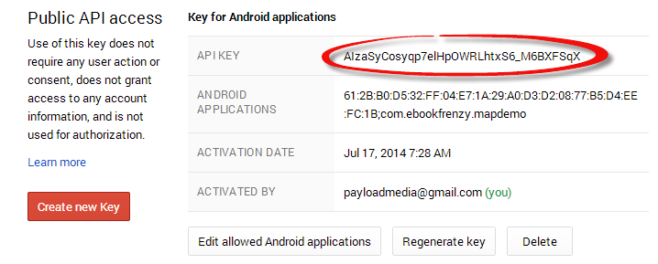
Embedding Google Maps into the App
5. Insert API_KEY in google_maps_api.xml:
<string name="google_maps_key" templateMergeStrategy="preserve">YOUR_KEY_HERE</string>

Slide 12
Geocoding
Convert address to coordinates:
double latitude, longitude;
List<Address> geocodeMatches = null;
try {
geocodeMatches = new Geocoder(this).getFromLocationName(
"600 Independence Ave SW, Washington, DC 20560", 1);
}
catch (IOException e) {
e.printStackTrace();
}
if (!geocodeMatches.isEmpty()) {
latitude = geocodeMatches.get(0).getLatitude();
longitude = geocodeMatches.get(0).getLongitude();
}

Slide 13
Reverse Geocoding
Convert coordinates to address:
List<Address> geocodeMatches = null;
String Address1, Address2, State, Zipcode, Country;
try {
geocodeMatches =
new Geocoder(this).getFromLocation(38.8874245, -77.0200729, 1);
}
catch (IOException e) {
e.printStackTrace();
}
if (!geocodeMatches.isEmpty()) {
Address1 = geocodeMatches.get(0).getAddressLine(0);
Address2 = geocodeMatches.get(0).getAddressLine(1);
State = geocodeMatches.get(0).getAdminArea();
Zipcode = geocodeMatches.get(0).getPostalCode();
Country = geocodeMatches.get(0).getCountryName();
}

Slide 14
Add Map as a Fragment
<fragment xmlns:android="http://schemas.android.com/apk/res/android"
xmlns:tools="http://schemas.android.com/tools"
android:layout_width="match_parent"
android:layout_height="match_parent"
android:id="@+id/map"
tools:context=".MapDemoActivity"
android:name="com.google.android.gms.maps.SupportMapFragment"/>

Slide 15
Set Current Location on Map
@Override
protected void onCreate(Bundle savedInstanceState) {
super.onCreate(savedInstanceState);
setContentView(R.layout.activity_map_demo);
setUpMapIfNeeded();
if (mMap != null) {
mMap.setMyLocationEnabled(true);
}
}

Slide 16
Set Map Type
GoogleMap.MAP_TYPE_NONE – An empty grid with no mapping tiles displayed.
GoogleMap.MAP_TYPE_NORMAL – The standard view consisting of the classic road map.
GoogleMap.MAP_TYPE_SATELLITE – Displays the satellite imagery of the map region.
GoogleMap.MAP_TYPE_HYBRID – Displays satellite imagery with the road maps superimposed.
GoogleMap.MAP_TYPE_TERRAIN – Displays topographical information such as contour lines and colors.
@Override
protected void onCreate(Bundle savedInstanceState) {
super.onCreate(savedInstanceState);
setContentView(R.layout.activity_map_demo);
setUpMapIfNeeded();
if (mMap != null) {
mMap.setMyLocationEnabled(true);
mMap.setMapType(GoogleMap.MAP_TYPE_TERRAIN);
}
}

Slide 17
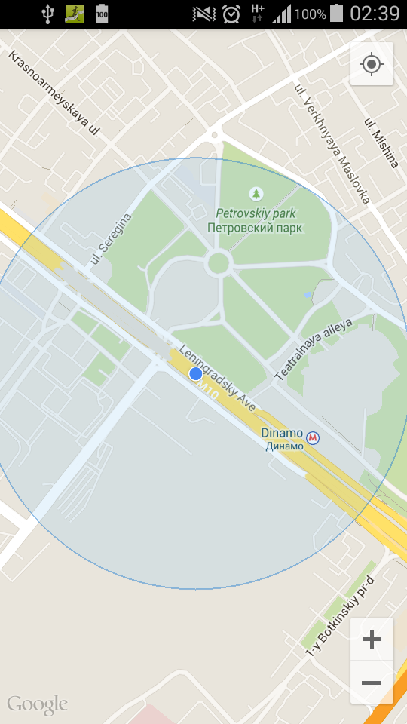
Add Controls
UiSettings mapSettings;
mapSettings = map.getUiSettings();
mapSettings.setZoomControlsEnabled(true);
mapSettings.setCompassEnabled(true);
mapSettings.setMyLocationEnabled(true);

Slide 18
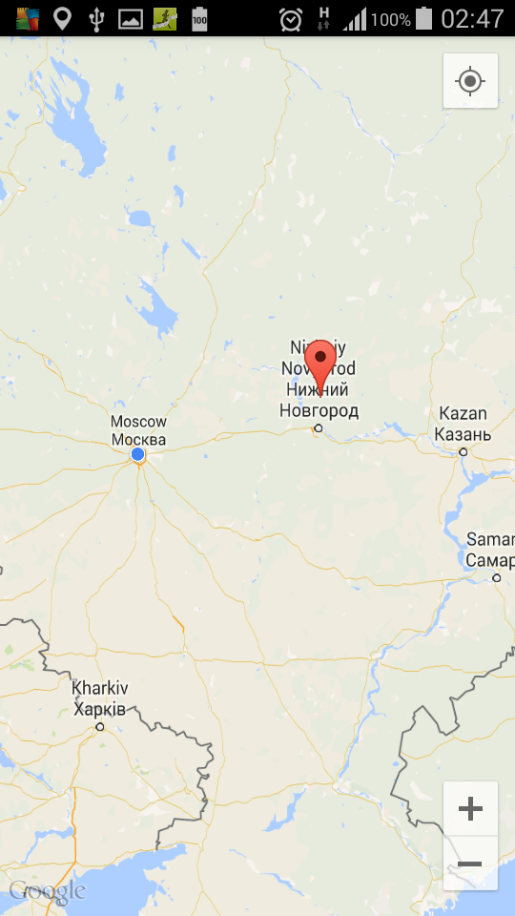
Set Markers
LatLng MUSEUM = new LatLng(38.8874245, -77.0200729);
Marker museum = mMap.addMarker(new MarkerOptions()
.position(MUSEUM)
.title("Museum")
.snippet("National Air and Space Museum"));
Sample: MapsDemo

Slide 19
Android Sensors

Slide 20
Android Sensors & Listeners
Android Sensors supports several sensors via the SensorManager, for example the accelerometer. Unfortunately, you cannot test the accelerometer on the Android emulator.
You can access a SensorManager via
getSystemService(SENSOR_SERVICE).
The Sensor class defines several constants for accessing the different sensors.
Sensor.TYPE_GYROSCOPE
Sensor.TYPE_MAGNETIC_FIELD
Sensor.TYPE_ORIENTATION
Sensor.TYPE_ACCELEROMETER
You can access the sensor via the sensorManager.getDefaultSensor() method, which takes the sensor type and the delay defined as constants on SensorManager as parameters.
Once you acquired a sensor, you can register a SensorEventListener object on it. This listener will get informed, if the sensor data changes. To avoid the unnecessary usage of battery power, you can register your listener in the onResume() method and de-register it in the onPause() method.

Slide 21
Accelerometer: Initialization
private SensorManager sensorManager;
public void onCreate(Bundle savedInstanceState) {
…….
sensorManager = (SensorManager) getSystemService(SENSOR_SERVICE);
lastUpdate = System.currentTimeMillis();
}
public void onSensorChanged(SensorEvent event) {
if (event.sensor.getType() == Sensor.TYPE_ACCELEROMETER) {
getAccelerometer(event);
}
}

Slide 22
Accelerometer: Start/Stop
@Override
protected void onResume() {
super.onResume();
// register this class as a listener for the orientation and accelerometer sensors
sensorManager.registerListener(this,
sensorManager.getDefaultSensor(Sensor.TYPE_ACCELEROMETER),
SensorManager.SENSOR_DELAY_NORMAL);
}
@Override protected void onPause() {
// unregister listener super.onPause();
sensorManager.unregisterListener(this);
}

Slide 23
Accelerometer: Event Handling
private void getAccelerometer(SensorEvent event) {
float[] values = event.values;
// Movement
float x = values[0];
float y = values[1];
float z = values[2];
float accelationSquareRoot = (x * x + y * y + z * z) / (SensorManager.GRAVITY_EARTH * SensorManager.GRAVITY_EARTH);
long actualTime = event.timestamp;
if (accelationSquareRoot >= 2) {
if (actualTime - lastUpdate < 200) { return; }
lastUpdate = actualTime;
Toast.makeText(this, "Device was shuffed", Toast.LENGTH_SHORT) .show();
if (color) {
view.setBackgroundColor(Color.GREEN);
} else {
view.setBackgroundColor(Color.RED);
} color = !color;
}
}
Sample: ChameleonApp

Slide 24
Bluetooth Low Energy protocol and BLE Beacons

Slide 25
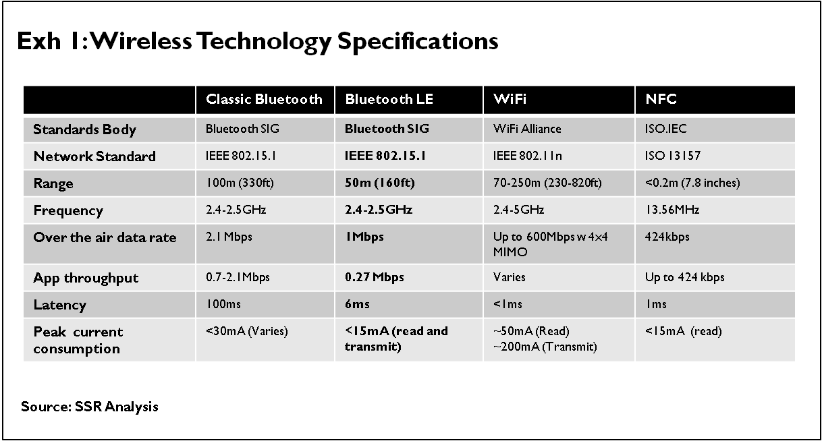
Bluetooth vs BLE

Slide 26
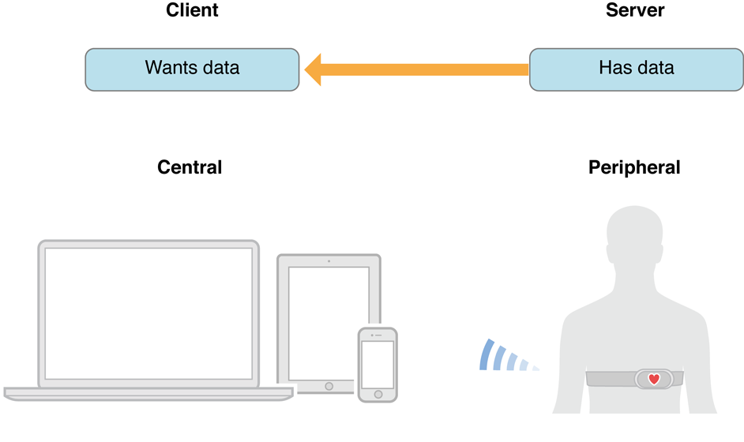
BLE Roles

Slide 27
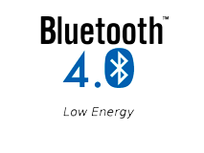
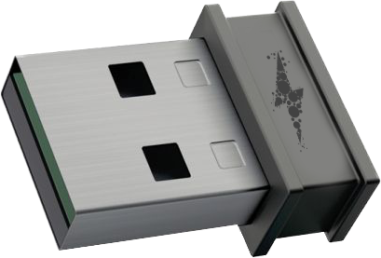
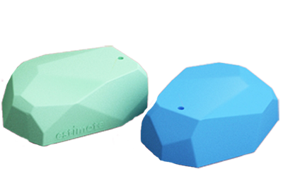
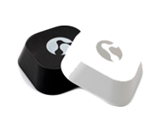
What is a BLE beacon?
A BLE Beacon is a low-powered, low-cost micro device which can transmit information via Bluetooth Low Energy protocol
Advantages: low-power consumption, relatively long working distance (up to 70 m), robustness and security
Platforms support: Android, iOS, Windows phone, BB10
Vendors: Estimote, Radius, Gimbal and many, many others , price: $ 15- 30 /beacon

Slide 28
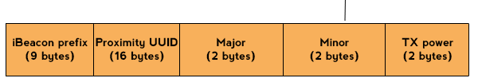
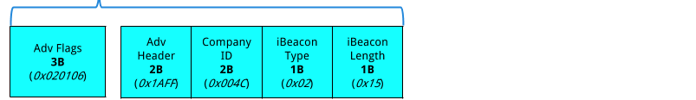
What data does BLE beacon advertise?

Slide 29

Essential Applications
1
2
3
Retail
Museums/Venues
Indoor navigation
Location based advertising, shopping assistance, contactless payments, expiration dates tracking
A mobile application can be used in museums to guide & educate visitors
Beacons can be used in malls & stores for indoor navigation and other purposes

Slide 30
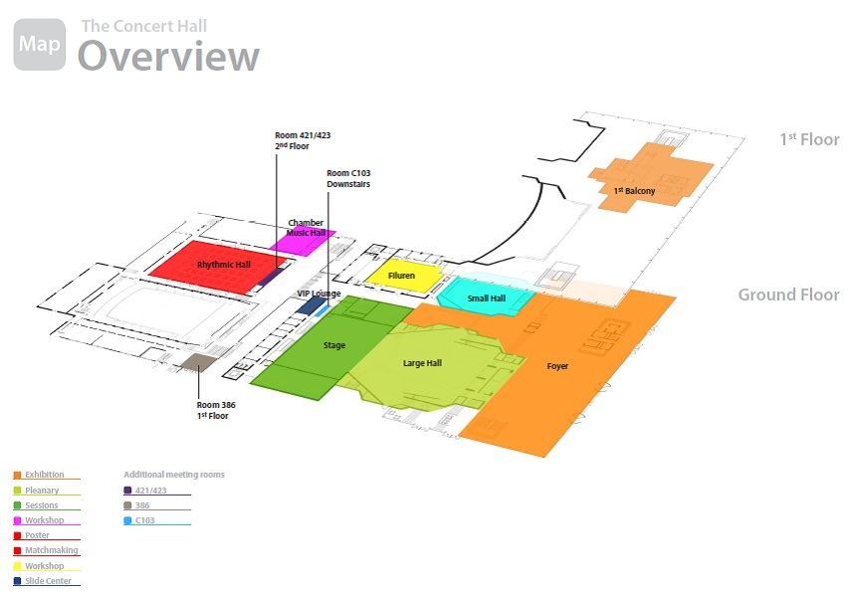
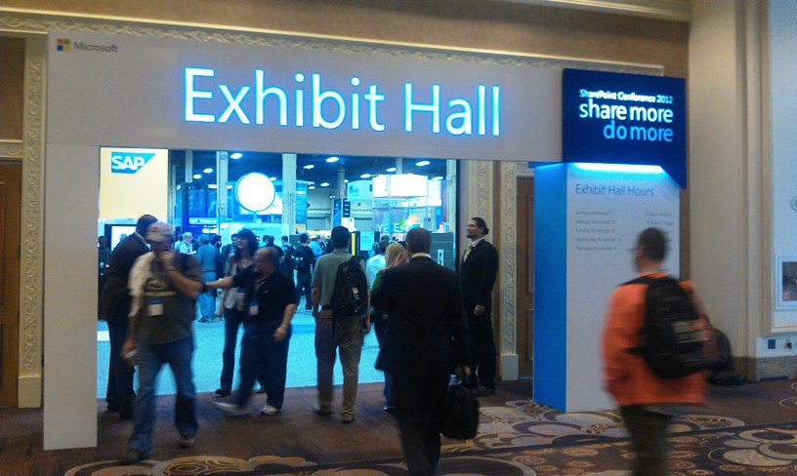
At a Venue: Indoor Navigation
Prerequisites:
Several beacons are placed in different points of the venue
User has downloaded and installed conference-specific mobile app
Use Case 1:
To show current user location within venue building on the map (like “You Are Here”)
Use Case 2:
User stands near one of the conference halls and gets agenda of sessions in this particular hall

Slide 31
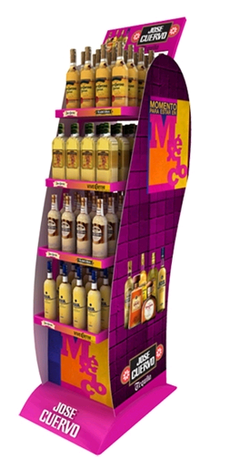

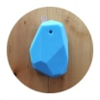
At a Store: Content Delivery
Prerequisites:
Beacons are placed behind display with some goods
User has downloaded and installed mobile app, then run it in background
Use Case:
Customer stands near display with some goods
Media Content is automatically delivered to his/her smartphone from the server. It can be:
Information about goods
Coupons or discount codes
TBD
Customer statistics is gathered and sent to the server. It can be:
how many people walked by the iBeacon
to how many we delivered the message
how many people opened the message delivered.
how many people download the coupon
TBD

Slide 32
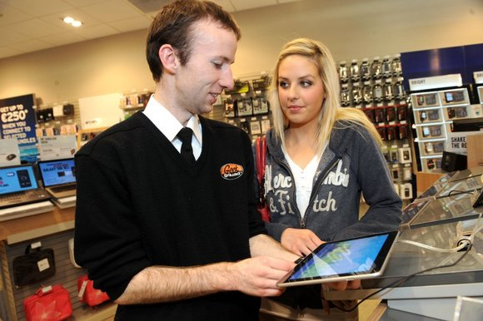
At a Store: Shopping Assistance
Prerequisites:
Beacons are placed behind display with some goods
User has downloaded and installed mobile app, then run it in background
Use Case:
Customer stands near display with some goods for relatively long period of time (like >1 min) or comes by this stand several times in 10 min
Shop Assistant get notification about that so he/she can come and offer help/advice to the customer

Slide 33
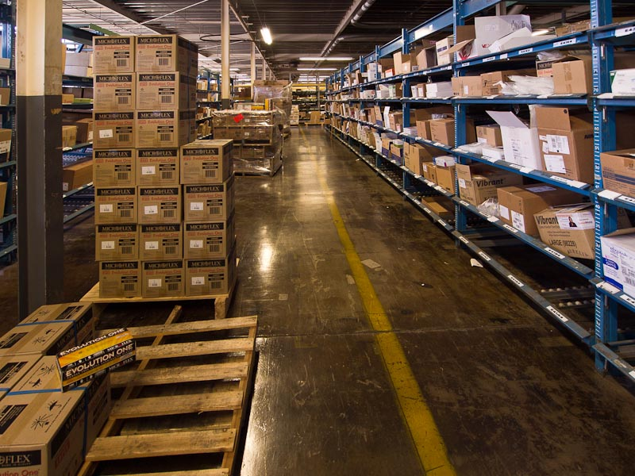
At a Storehouse: Expiration Dates
Prerequisites:
Beacon is placed on each shelve where particular batch of goods with the same expiration date is stored
Beacon is programmed so to advertise expiration date (major/minor values)
Storekeepers have mobile app installed
Use Case:
Storekeeper passes by stands and shelves with goods
As soon as mobile app discovers beacon which advertises expiration date close to current date (configurable range) it gives some signal (audio/video). It helps to identify expired goods.

Slide 34
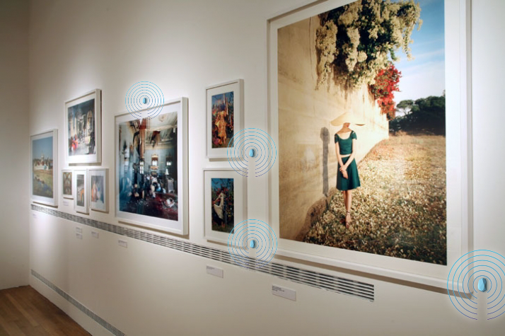
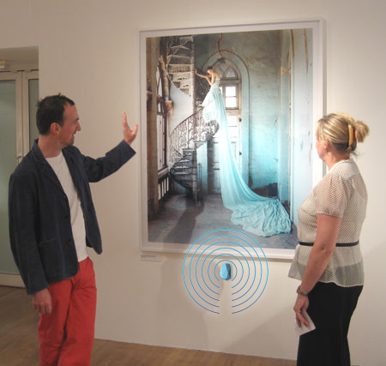
At a Museum Hall: Guidance
Prerequisites:
Beacons are placed near some pieces of art
User has downloaded and installed mobile app prior to exploring the exhibition
Use Case:
Visitor stands near some picture/sculpture
Media Content with some audio/video information connected with this particular piece of art is automatically delivered to his/her smartphone from the server.
Some statistics is can be gathered and sent to the server (like how many people passed by this exhibit, how many of them opened the delivered content, etc.)

Slide 35
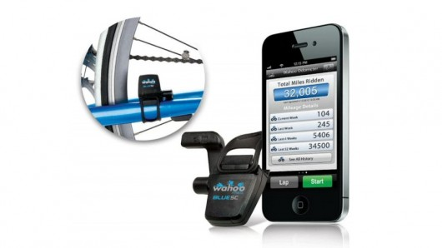
At a Gym: Data from Sensors
Prerequisites:
Special BLE sensors are placed on gym bike or other fitness device
Use Case:
User does some training on device
Data is collected by mobile app
Mobile app sends data to some cloud for storage and analytics

Slide 36
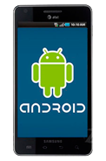
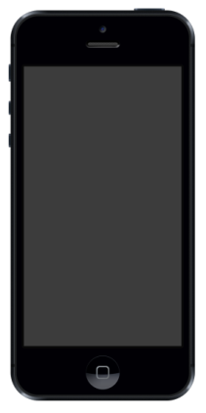
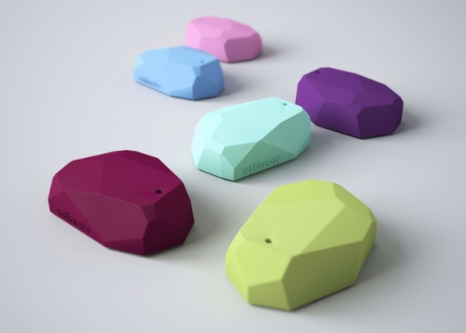
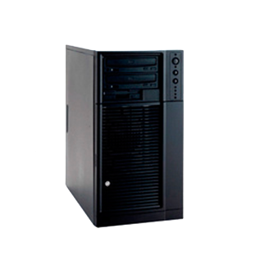
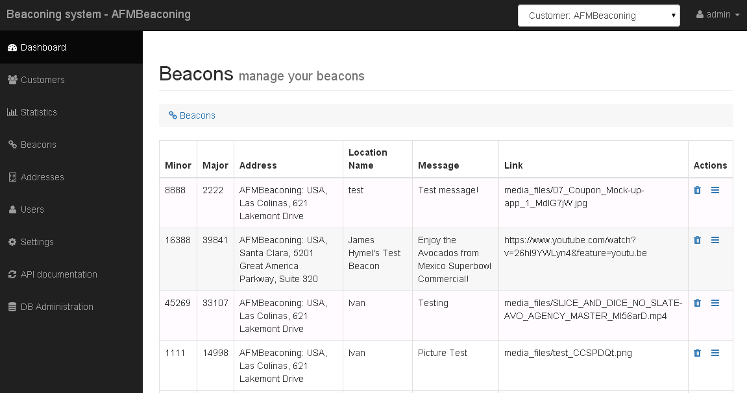
How it can work?
Advertises UUID
HTTP response with media content link
HTTP request with UUID and additional data
General idea:
This system illustrates how BLE beacons can be used to deliver rich media to mobile subscribers. Mobile devices detect the BLE beacon’s signal and pass the beacon’s ID to a web-server using a RESTful API. The web-server receives the ID and returns a link to the media which is played on the mobile. Mapping between the beacon ID and the proper media is performed via a Cloud-based interface to the CMS.
Web-server (DB & CMS)
Web-interface to CMS

Slide 37
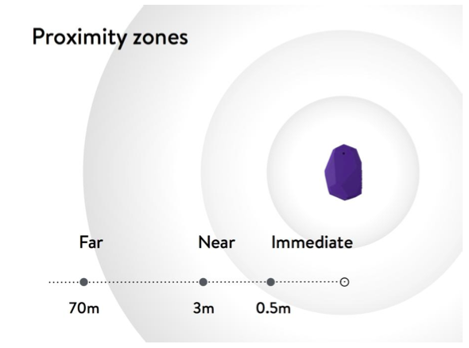

Some Technical Details of Solution
Beacons can be detected on distance up to 70 m. Received signal strength indication (RSSI) depends on the proximity of the beacon. By configuring RSSI threshold you can adjust approximate distance between mobile device and the beacon where beacon will be detected
Diagram which shows how mobile device detects beacons. Both periods are configurable via CMS
RSSI threshold
Scanning period
Pause period
Scanning period

Slide 38
BLE Discovery: Initialization
btManager = (BluetoothManager)getSystemService(Context.BLUETOOTH_SERVICE); btAdapter = btManager.getAdapter(); btScanner = btAdapter.getBluetoothLeScanner();
…
if (btAdapter != null && !btAdapter.isEnabled()) { Intent enableIntent = new Intent(BluetoothAdapter.ACTION_REQUEST_ENABLE); startActivityForResult(enableIntent,REQUEST_ENABLE_BT); }

Slide 39
BLE Discovery: Permissions
// Make sure we have access coarse location enabled, if not, prompt the user to enable it if (this.checkSelfPermission(Manifest.permission.ACCESS_COARSE_LOCATION) != PackageManager.PERMISSION_GRANTED) { final AlertDialog.Builder builder = new AlertDialog.Builder(this); builder.setTitle("This app needs location access"); builder.setMessage("Please grant location access so this app can detect peripherals."); builder.setPositiveButton(android.R.string.ok, null); builder.setOnDismissListener(new DialogInterface.OnDismissListener() { @Override public void onDismiss(DialogInterface dialog) { requestPermissions(new String[]{Manifest.permission.ACCESS_COARSE_LOCATION}, PERMISSION_REQUEST_COARSE_LOCATION); } }); builder.show(); }

Slide 40
BLE Discovery: Scanning
public void startScanning() { System.out.println("start scanning"); peripheralTextView.setText(""); startScanningButton.setVisibility(View.INVISIBLE); stopScanningButton.setVisibility(View.VISIBLE); AsyncTask.execute(new Runnable() { @Override public void run() { btScanner.startScan(leScanCallback); } }); }
public void stopScanning() { System.out.println("stopping scanning"); peripheralTextView.append("Stopped Scanning"); startScanningButton.setVisibility(View.VISIBLE); stopScanningButton.setVisibility(View.INVISIBLE); AsyncTask.execute(new Runnable() { @Override public void run() { btScanner.stopScan(leScanCallback); } }); }

Slide 41
BLE Discovery: Result
// Device scan callback. private ScanCallback leScanCallback = new ScanCallback() { @Override public void onScanResult(int callbackType, ScanResult result) { peripheralTextView.append("Device Name: " + result.getDevice().getName() + " rssi: " + result.getRssi() + "\n"); };
Sample: BLEScanner

